Slide 1
Second Year B. Tech. Advanced Data Structures (CS228)
By
Dr. Pramod D. Ganjewar
Senior Assistant Professor,
School of Computer Engineering,
MIT Academy of Engineering, Alandi(D.),Pune

Slide 2
Unit – 1 Trees Binary Search Tree (BST) and its Construction

Slide 3
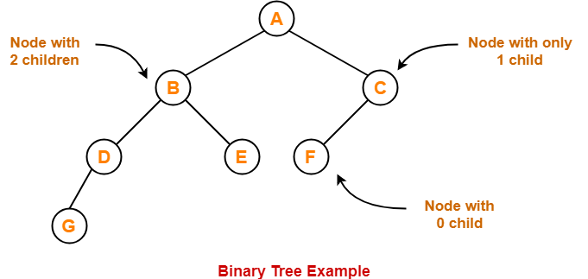
Binary Tree
Binary Tree
Binary tree is a special tree data structure in which each node can have at most 2 children.
Thus, in a binary tree, Each node has either 0 child or 1 child or 2 children.

Slide 4
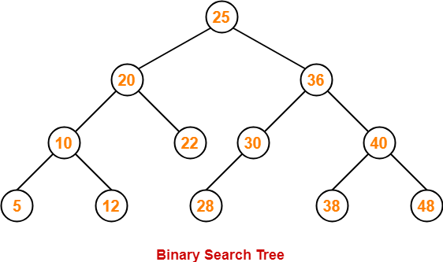
Binary Search Tree
Binary Search Tree
Binary Search Tree is a special kind of binary tree in which nodes are arranged in a specific order.
In a binary search tree (BST), each node contains-
Only smaller values in its left sub tree
Only larger values in its right sub tree

Slide 5
Binary Search Tree Construction
Let us understand the construction of a binary search tree using the following example-
Example-
Construct a Binary Search Tree (BST) for the following sequence of numbers - 50, 70, 60, 20, 90, 10, 40, 100
When elements are given in a sequence,
Always consider the first element as the root node.
Consider the given elements and insert them in the BST one by one.

Slide 6

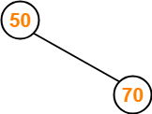
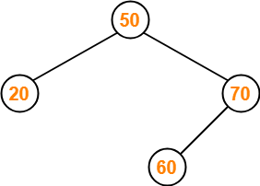
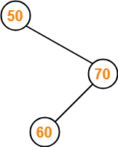
Binary Search Tree Construction
Construction of BST for input :- 50, 70, 60, 20, 90, 10, 40, 100
Insert 50 –
Insert 20-
As 20 < 50, so insert 20 to the left of 50.
Insert 70 -
As 70 > 50, so insert 70 to the right of 50.
Insert 60 -
As 60 > 50, so insert 60 to the right of 50.
As 60 < 70, so insert 60 to the left of 70.

Slide 7
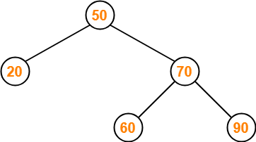
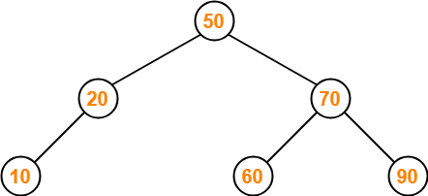
Binary Search Tree Construction
Construction of BST for input :- 50, 70, 60, 20, 90, 10, 40, 100
Insert 90-
As 90 > 50, so insert 90 to the right of 50.
As 90 > 70, so insert 90 to the right of 70.
Insert 10-
As 10 < 50, so insert 10 to the left of 50.
As 10 < 20, so insert 10 to the left of 20.

Slide 8
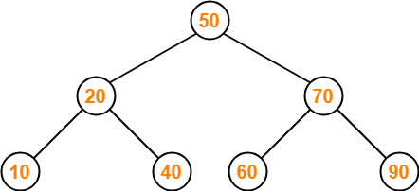
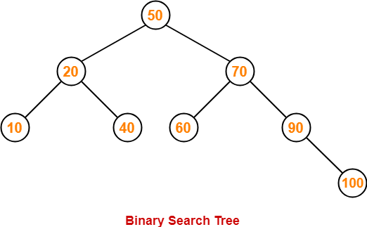
Binary Search Tree Construction
Construction of BST for input :- 50, 70, 60, 20, 90, 10, 40, 100
Insert 40-
As 40 < 50, so insert 40 to the left of 50.
As 40 > 20, so insert 40 to the right of 20.
Insert 100-
As 100 > 50, so insert 100 to the right of 50.
As 100 > 70, so insert 100 to the right of 70.
As 100 > 90, so insert 100 to the right of 90.

Slide 9
Binary Search Tree Construction
Final BST for input :- 50, 70, 60, 20, 90, 10, 40, 100

Slide 10
Thank You

